Slide 1
A Comparative Analysis of Microplastic Distribution in Snowfall
Diego Schillaci

Slide 2
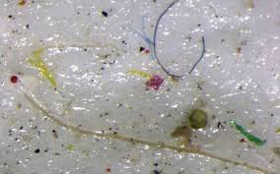
Introduction
Microplastics (MP): less than 5mm in size come in many different forms
MP particles can be found in precipitation

Slide 3
Introduction
Snowpack: Lasting snow in an area​​
Snow Water Equivalent (SWE)
Atmospheric transport: movement of pollutants in the atmosphere caused by wind flow

Slide 4
Review of Literature
ORIGINS OF MICROPLASTICS
Synthetic microfibers from fabrics
Degradation of macro plastics
Rubber particulates
Rodrigues MO, Abrantes N, Gonçalves FJM, Nogueira H, Marques JC, Gonçalves AMM. Spatial and temporal distribution of microplastics in water and sediments of a freshwater system (Antuã River, Portugal). Sci Total Environ. 2018 Aug 15;633:1549-1559. doi: 10.1016/j.scitotenv.2018.03.233. Epub 2018 Apr 4. PMID: 29758905.

Slide 5
Review of Literature
1000 metric tons of MPs fall within western U.S. each year
Plastic rain in protected areas of the United States JANICE BRAHNEY, MARGARET HALLERUD, ERIC HEIM, MAURA HAHNENBERGER, SUJA SUKUMARAN SCIENCE12 JUN 2020 : 1257-1260
Large number of MPs found on Mt. Everest
Imogen E. Napper, Bede F.R. Davies, Heather Clifford, Sandra Elvin, Heather J. Koldewey, Paul A. Mayewski, Kimberley R. Miner, Mariusz Potocki, Aurora C. Elmore, Ananta P. Gajurel, Richard C. Thompson, Reaching New Heights in Plastic

Slide 6
Review of Literature
Atmospheric transport and deposition are pathways for MPs
Microplastics reach remote areas through atmospheric transport
Bergmann M, Mützel S, Primpke S, Tekman MB, Trachsel J, Gerdts G. White and wonderful? Microplastics prevail in snow from the Alps to the Arctic. Sci Adv. 2019 Aug 14;5(8):eaax1157. doi: 10.1126/sciadv.aax1157. PMID: 31453336; PMCID: PMC6693909
Water vapor can bind to MP particles
Allen, Steve & Allen, Deonie & Phoenix, Vernon & Le Roux, Gaël & Jiménez, Pilar & Simonneau, anaëlle & Binet, Stéphane & Galop, Didier. (2019). Atmospheric transport and deposition of microplastics in a remote mountain catchment. Nature Geoscience. 12. 10.1038/s41561-019-0335-5.

Slide 7
Hypothesis
Microplastic distribution will strongly correlate with snow deposition when measured in rural and urban sites.

Slide 8
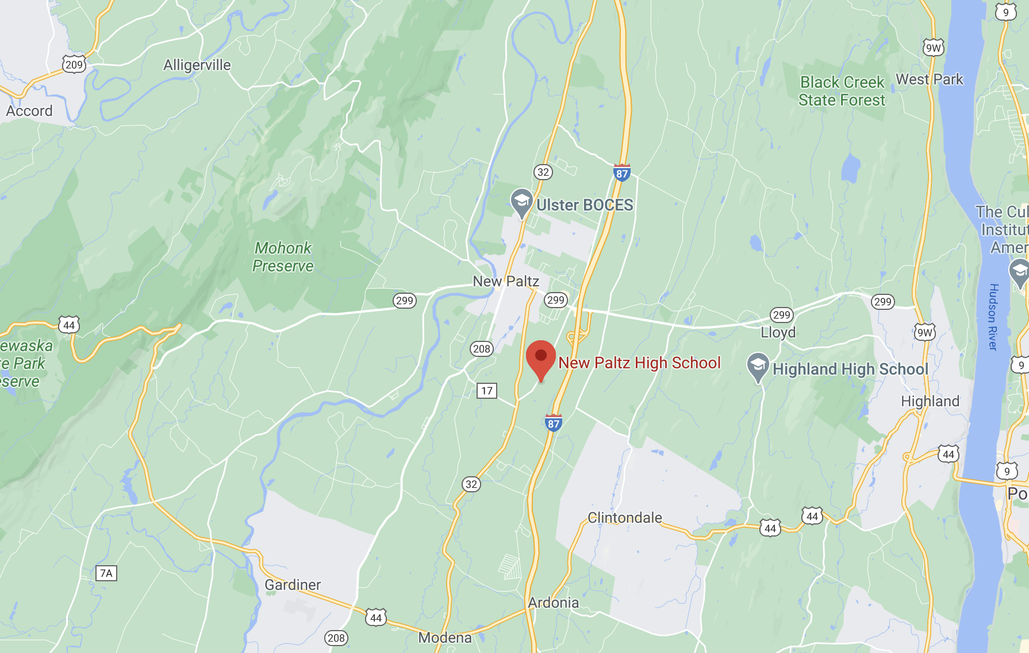
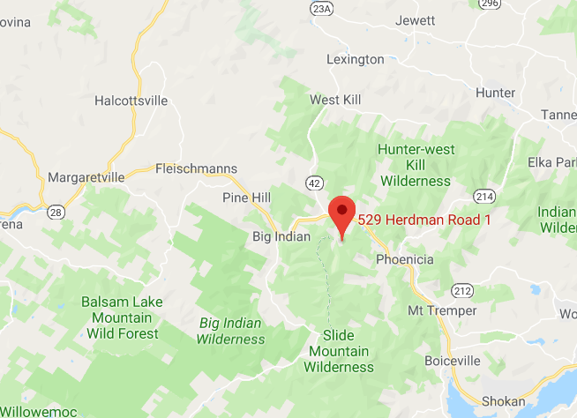
Methodology
SITE SELECTION
Remote site in the Catskill Mountains, NY
Urban site in New Paltz, NY

Slide 9
Methodology
METEOROLOGICAL DATA
Historical and current wind speed and direction
Frequency and severity of precipitation
Air Temperature and Humidity

Slide 10
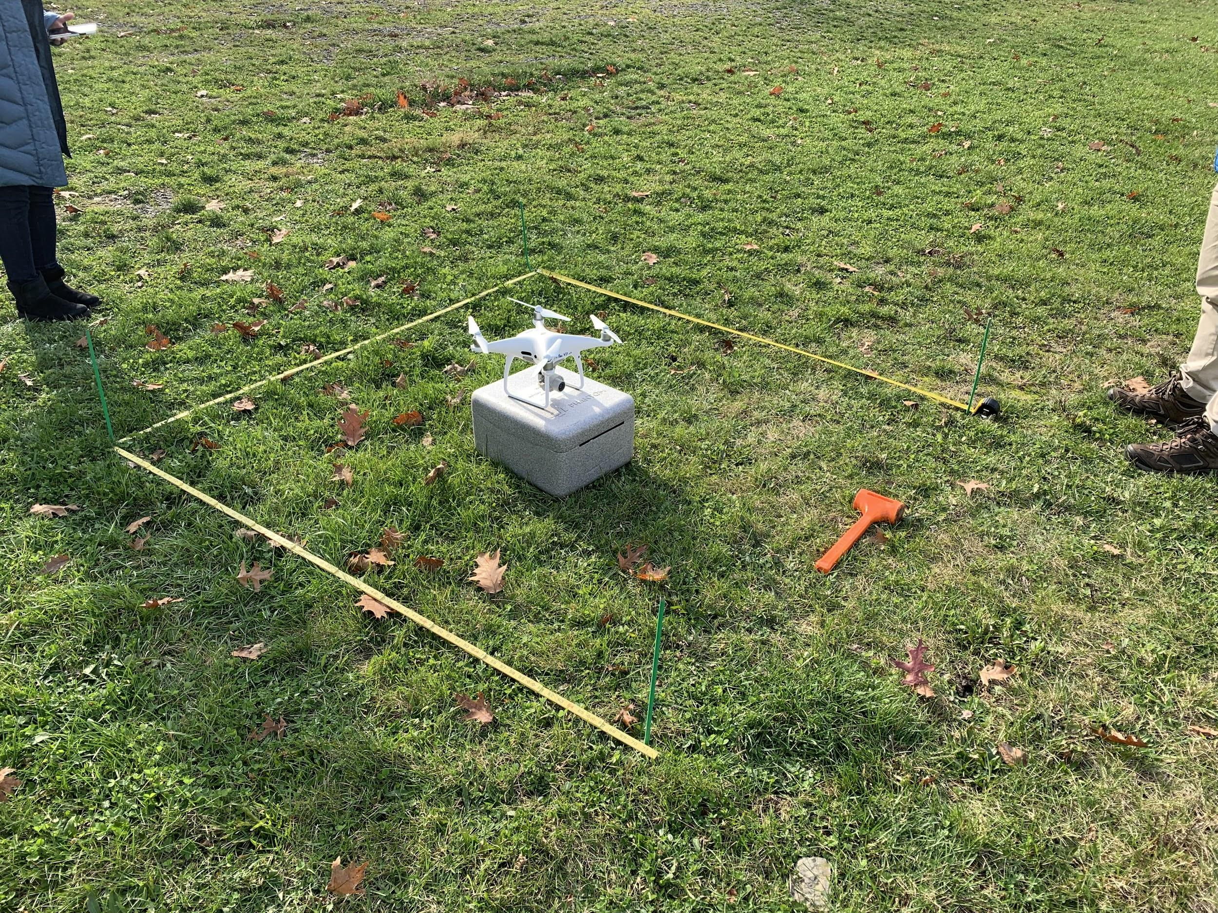
Methodology
DRONE SPATIAL ANALYSIS
Photographs compiled, made into a Structure From Motion (SFM) file
Drone is flown during times of snow cover and bare ground
SFM models overlayed to determine snow depth

Slide 11
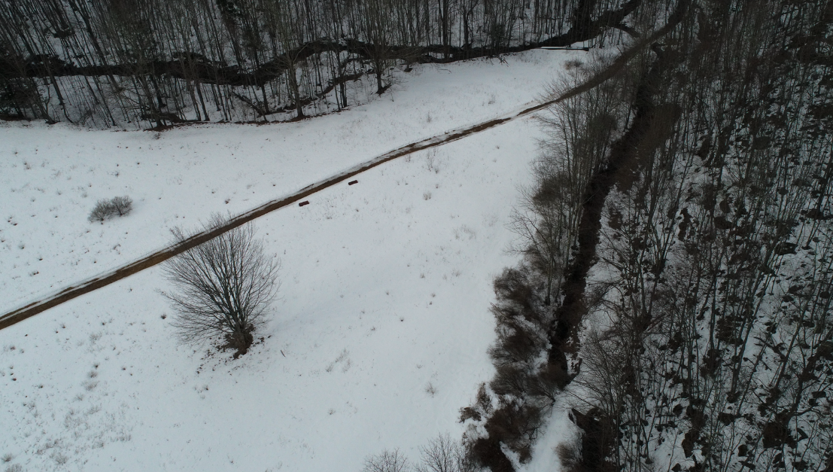
Methodology

Slide 12
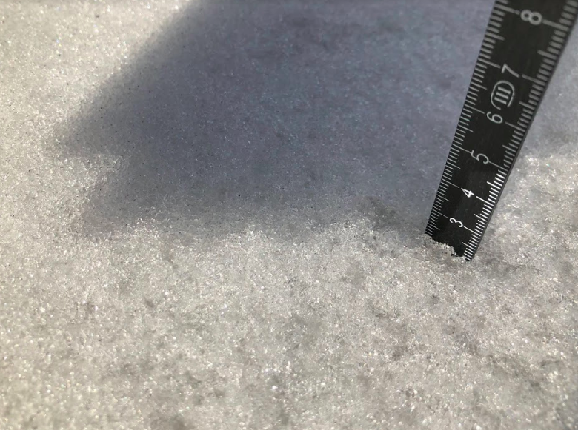
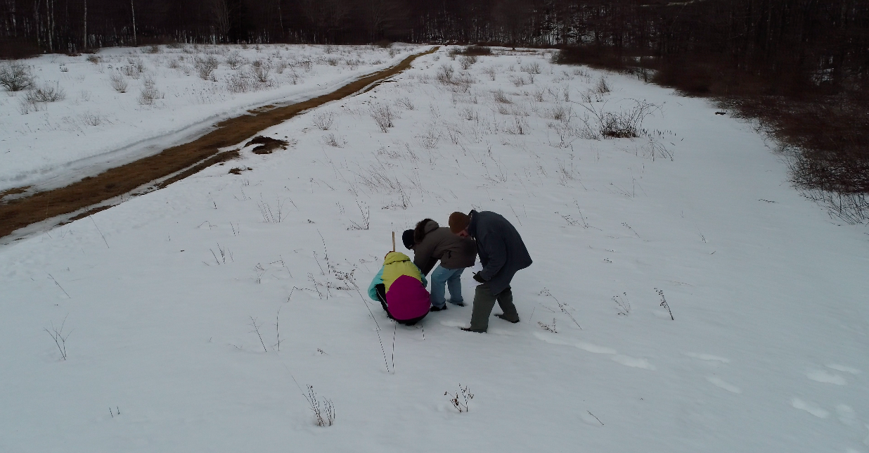
Methodology
SNOW DATA
Not disturbing snow was of utmost priority
Collected in Zig-Zag pattern
SWE measurements collected
Depth data was recorded with metric ruler and GPS device

Slide 13
Results
SNOW DATA
Lack of sufficient snowfall for microplastic data collection
February 6th 2019 snow condition data was collected from the remote and urban sites
Variability in snow depth likely results from the topographic variability and wind redistribution

Slide 14
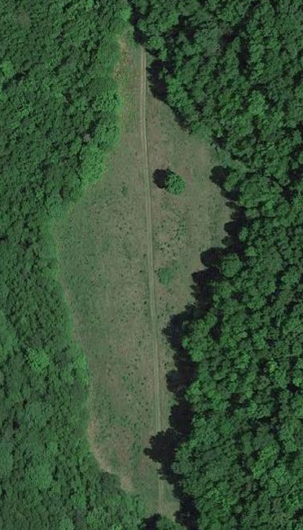
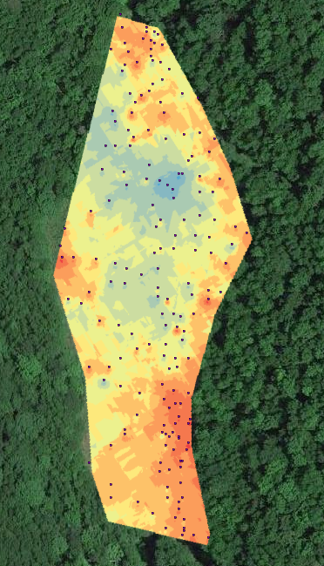
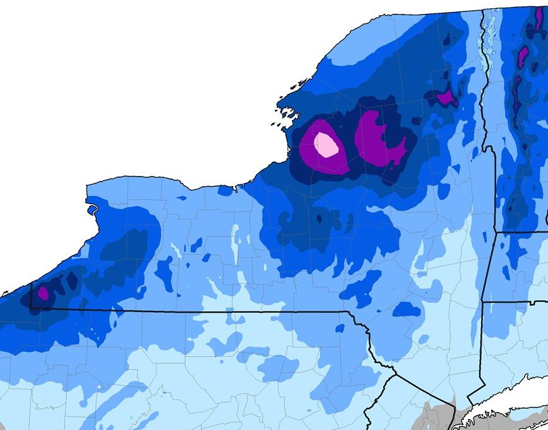
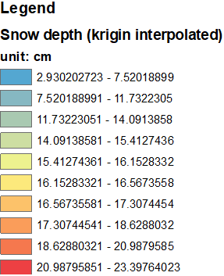
Results
Snow Data
https://www.weather.gov/buf/wintersummary1819

Slide 15
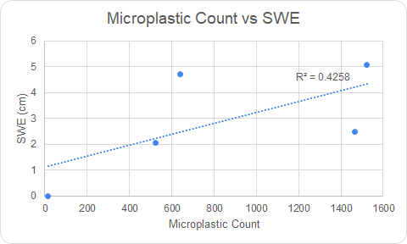
Results
MICROPLASTIC DATA
The correlation between Microplastic count and SWE is 0.4258.

Slide 16
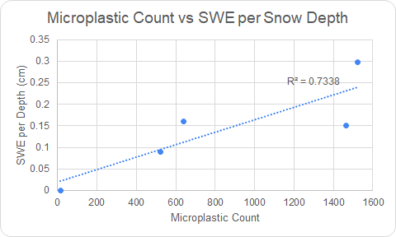
Results
MICROPLASTIC DATA
Microplastic count vs SWE per Snow Depth was a more accurate predictor of MP distribution with a Correlation of 0.7338

Slide 17
Results
METEOROLOGICAL DATA
Data from early 2019 highlights the unpredictability of weather
Vast meteorological difference recorded between Sites
Extreme temperature fluctuation at urban site

Slide 18
Results
METEOROLOGICAL DATA
Meteorological Data for the Remote Catskill site, Feb 2019
Meteorological for the Developed New Paltz site, Feb 2019

Slide 19
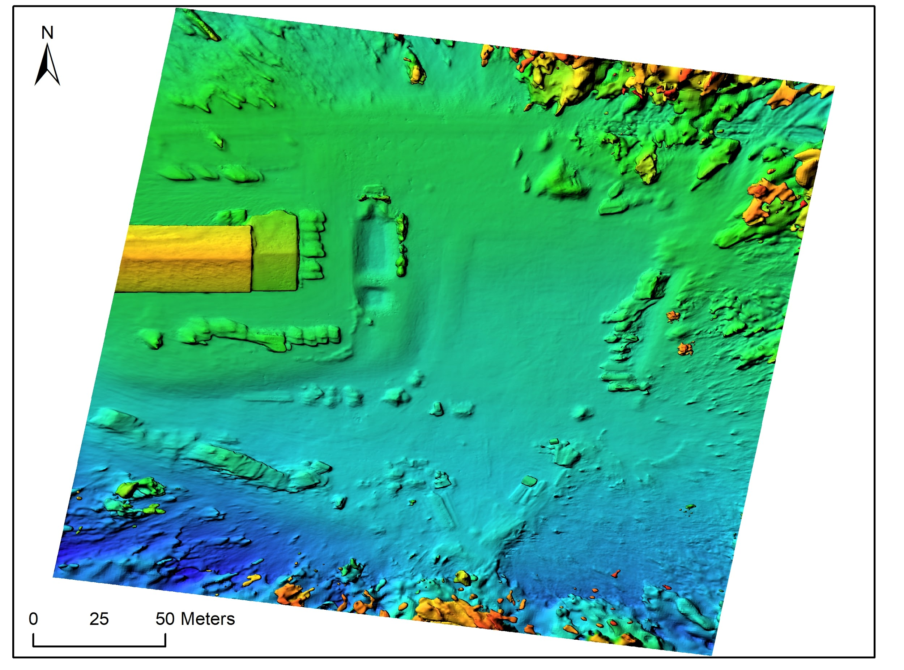
Results
DRONE SPATIAL ANALYSIS
Used to validate the snow depth data
Photographs were processed using the PhotoScan software to produce a SFM of the field site

Slide 20
Discussion
Variability in snow depth results from topographic variability, wind redistribution
New York State 2019-2020 winter snowfall at new record low
Extreme temperature fluctuation makes it very difficult for a sustainable snowpack to develop

Slide 21
Discussion
Similar wind patterns aid in MP distribution
SWE
Snow depth and SWE can be a predictor for distribution of MP particles due to large scale atmospheric transport and deposition

Slide 22
Conclusion
There is strong evidence MP distribution strongly correlates with snow deposition and SWE when snow depth is accounted for

Slide 23
Works Cited
Bellasi, A.; Binda, G.; Pozzi, A.; Galafassi, S.; Volta, P.; Bettinetti, R. Microplastic Contamination in Freshwater Environments: A Review, Focusing on Interactions with Sediments and Benthic Organisms. Environments 2020, 7, 30.
Production, use, and fate of all plastics ever made BY ROLAND GEYER, JENNA R. JAMBECK, KARA LAVENDER LAW
SCIENCE ADVANCES19 JUL 2017 : E1700782
Allen, Steve & Allen, Deonie & Phoenix, Vernon & Le Roux, Gaël & Jiménez, Pilar & Simonneau, anaëlle & Binet, Stéphane & Galop, Didier. (2019). Atmospheric transport and deposition of microplastics in a remote mountain catchment. Nature Geoscience. 12. 10.1038/s41561-019-0335-5.
Bergmann M, Mützel S, Primpke S, Tekman MB, Trachsel J, Gerdts G. White and wonderful? Microplastics prevail in snow from the Alps to the Arctic. Sci Adv. 2019 Aug 14;5(8):eaax1157. doi: 10.1126/sciadv.aax1157. PMID: 31453336; PMCID: PMC6693909.
Imogen E. Napper, Bede F.R. Davies, Heather Clifford, Sandra Elvin, Heather J. Koldewey, Paul A. Mayewski, Kimberley R. Miner, Mariusz Potocki, Aurora C. Elmore, Ananta P. Gajurel, Richard C. Thompson, Reaching New Heights in Plastic Pollution—Preliminary Findings of Microplastics on Mount Everest, One Earth, Volume 3, Issue 5, 2020, Pages 621-630, ISSN 2590-3322.

Slide 24
Works Cited
(6) Evangeliou, N., Grythe, H., Klimont, Z. et al. Atmospheric transport is a major pathway of microplastics to remote regions. Nat Commun 11, 3381 (2020).
(7) Watson AY, Bates RR, Kennedy D, editors. Air Pollution, the Automobile, and Public Health. Washington (DC): National Academies Press (US); 1988. Atmospheric Transport and Dispersion of Air Pollutants Associated with Vehicular Emissions.
(8) Won Joon Shim, Young Kyoung Song, Sang Hee Hong, Mi Jang, Identification and quantification of microplastics using Nile Red staining, Marine Pollution Bulletin, Volume 113, Issues 1–2, 2016
(9) Rodrigues MO, Abrantes N, Gonçalves FJM, Nogueira H, Marques JC, Gonçalves AMM. Spatial and temporal distribution of microplastics in water and sediments of a freshwater system (Antuã River, Portugal). Sci Total Environ. 2018 Aug 15;633:1549-1559. doi: 10.1016/j.scitotenv.2018.03.233. Epub 2018 Apr 4. PMID: 29758905.

